Slide 1
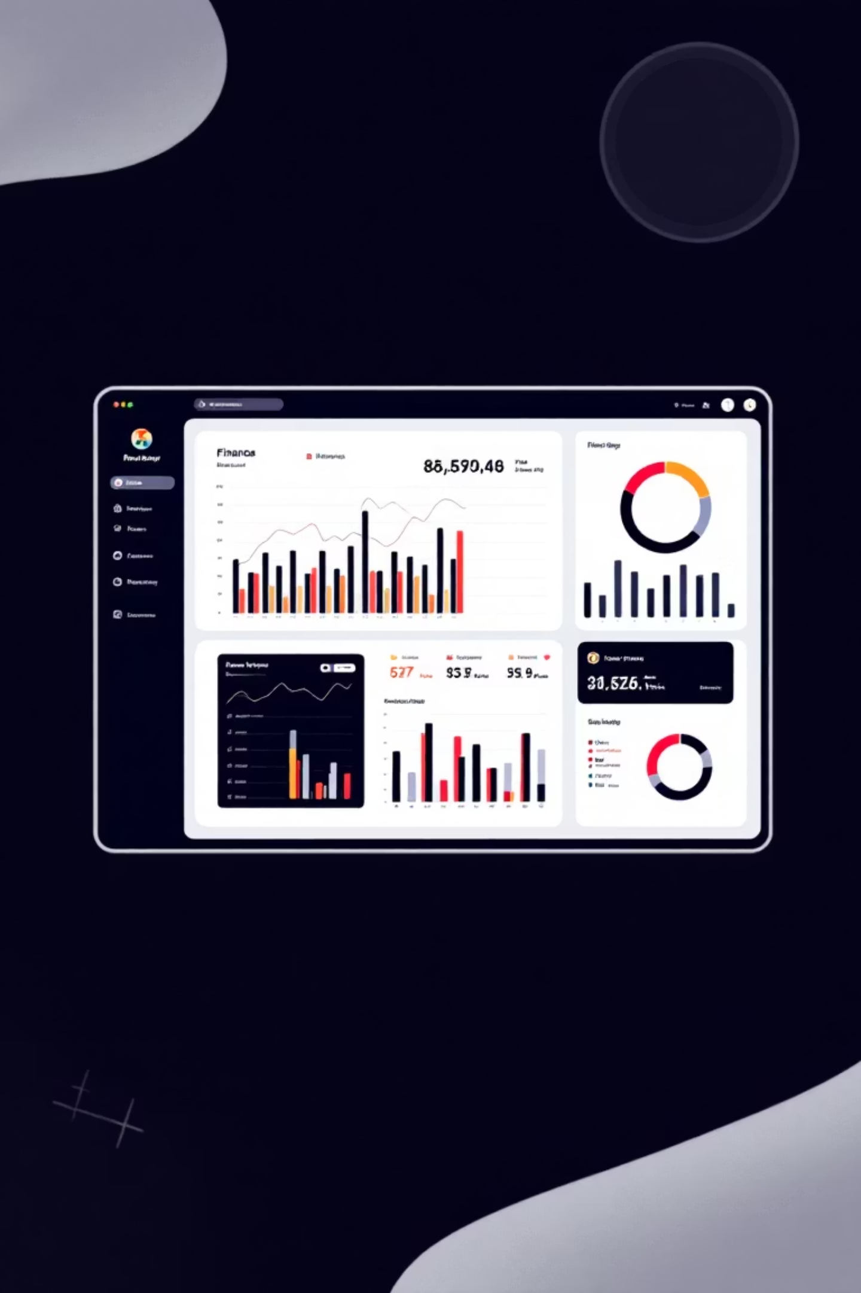
The Personal Finance Manager
Python-Powered Financial Clarity for You
A simple and interactive Personal Finance Management System built using Python, SQLite, and Streamlit. This application allows you to manage, track, and visualize your financial transactions easily through a clean, web-based interface.
Now that we've introduced the Personal Finance Manager, let's explore the key features that empower you to take control of your financial journey.

Slide 2

Core Technology Stack
This robust application is built using a powerful and efficient combination of technologies, ensuring reliability, responsiveness, and ease of use.
Python 3.x
SQLite
The core programming language provides structure, logic, and comprehensive libraries for data handling and computation.
A self-contained, high-reliability, zero-configuration SQL database engine for persistent, secure data storage and retrieval.
Streamlit
Pandas & Matplotlib
Used for creating the intuitive, interactive, and responsive web-based user interface with minimal development overhead.
Essential libraries for efficient data manipulation, analysis, and generation of powerful, dynamic financial visualizations.
Building on this foundation, let's now explore the key functionalities and features that these technologies bring to life in the Personal Finance Manager.

Slide 3
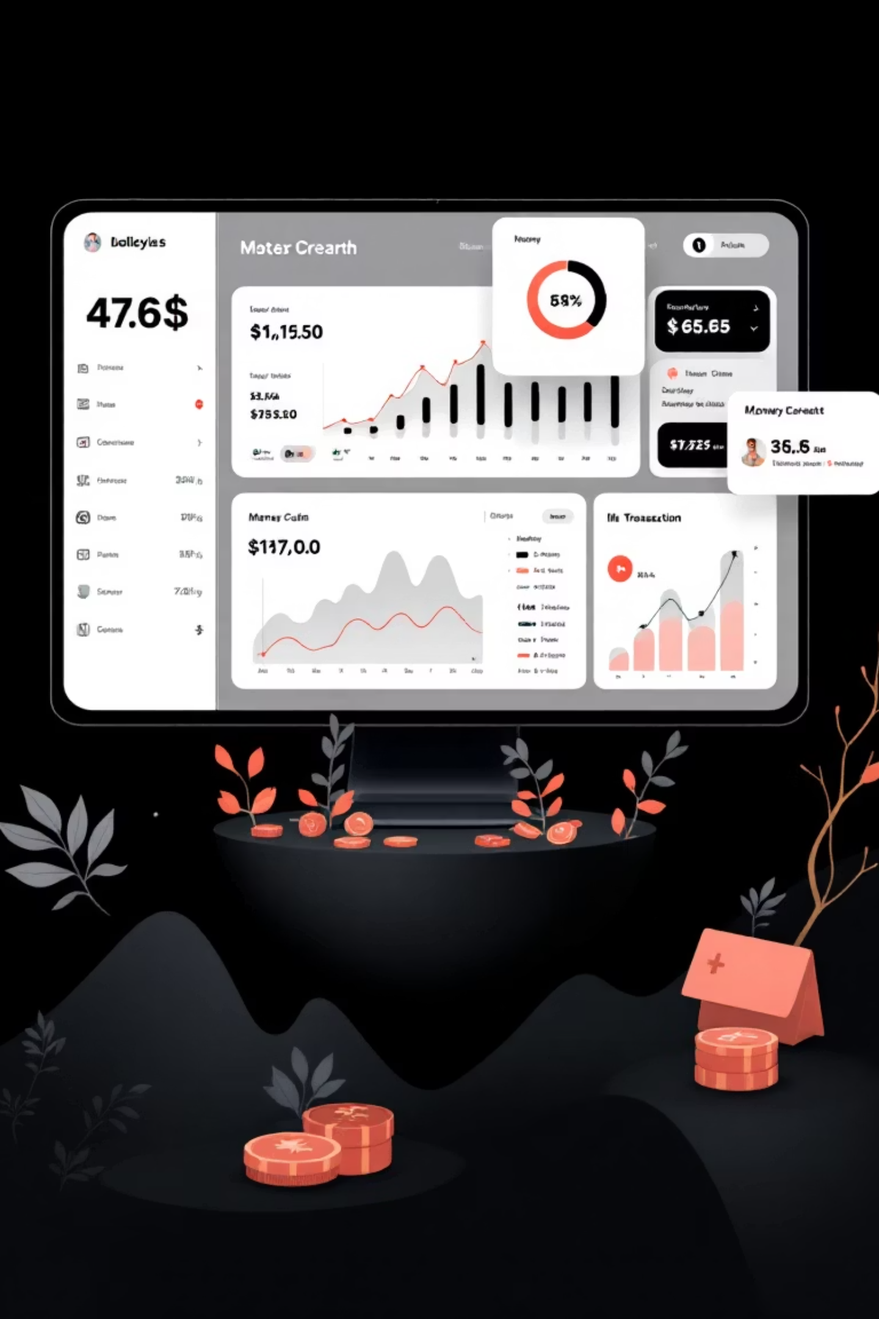
Key Application Features
The Finance Manager provides a full suite of features necessary for comprehensive transaction management, from entry to analysis.
Add Transactions
Input new transactions with detailed fields: ID, Type (Credited/Debited), Purpose, Amount, and Date.
View Records
See all recorded transactions in a clear, sortable tabular format, along with dynamic balance calculation.
Update & Delete
Maintain data accuracy by modifying existing transaction details or permanently deleting outdated entries.
Search by Date
Quickly retrieve transactions for specific dates or across custom date ranges for targeted review.
With these comprehensive features, users can efficiently manage their finances. Now, let's explore how these translate into tangible benefits and real-world impact.

Slide 4
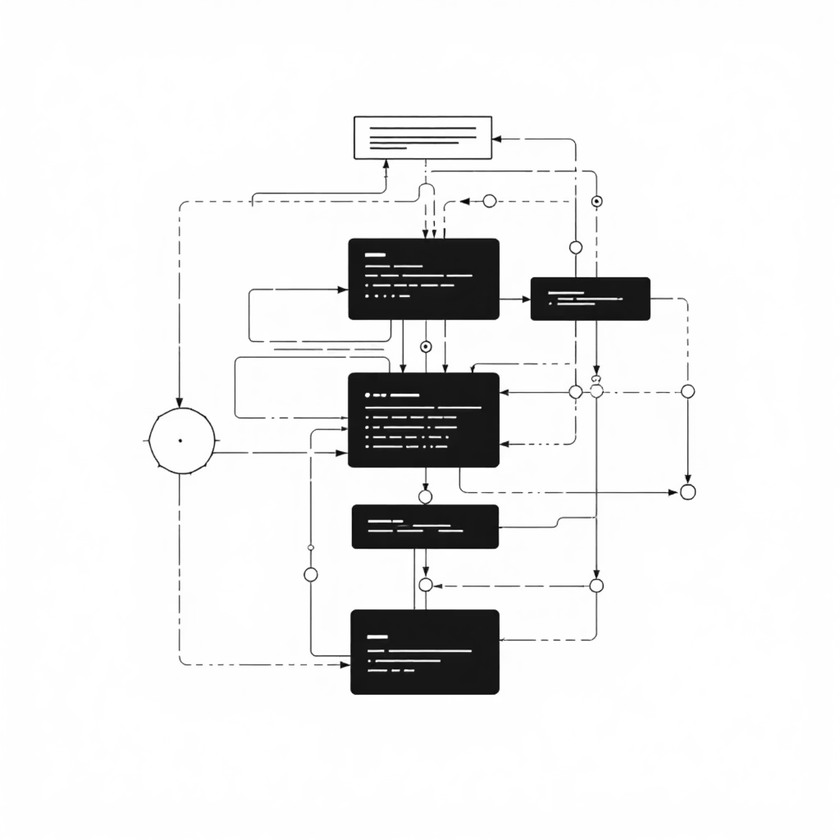
Database Integrity: The SQLite Foundation
The system uses SQLite to ensure that your financial records are structured, persistent, and reliable. The initial setup ensures a stable foundation for all future operations.
Schema Definition
The core 'expenses' table enforces data structure and consistency for every transaction recorded.
CREATE TABLE IF NOT EXISTS expenses ( TransactionNumber INTEGER PRIMARY KEY, Transaction_ID TEXT, Transaction_Type TEXT, Purpose TEXT, Amount REAL, Date TEXT);
Primary Key: TransactionNumber ensures every entry is unique.
Transaction Type: Categorized as 'Credited' or 'Debited'.
Amount: Stored as a REAL number for precision.
Commitment: Changes are immediately saved using con.commit().
Building on this foundation of robust database integrity, let's now explore how these structured records are accessed and managed through the application's user interface.

Slide 5

Adding New Transactions
The dedicated 'Add Transaction' interface in Streamlit simplifies data entry while validating inputs to maintain data quality.
Unique Identifiers
Input & Validation
Requires a unique Transaction Number and a 12-digit Transaction ID to prevent duplicate entries.
Fields for Type (Dropdown), Purpose (Text), Amount (Minimum 0.0), and Date (Date Picker) ensure accurate logging.
Feedback Mechanism
Upon submission, the system provides a success message or an error warning if the Transaction Number already exists (IntegrityError).
st.success(f"✅ Transaction {tno} added successfully!")
Now that we understand how transactions are securely added and validated, let's explore how we view and interact with this data.

Slide 6
Comprehensive View and Financial Summary
The 'View Transactions' section does more than just list entries; it provides immediate, high-level financial insights.
Data Presentation
Calculated Metrics
All data is fetched from the SQLite database into a Pandas DataFrame and displayed in a responsive Streamlit DataFrame, allowing users to scroll and sort easily.
Key metrics are dynamically calculated based on the displayed data:
₹400K
101
Credited
₹15,000
Monthly Salary
102
Debited
₹2,500
Grocery Shopping
Total Credited
103
Credited
₹500
Interest
₹150K
Total Debited
₹250K
Current Balance
These immediate, high-level financial insights provide a solid foundation for understanding our financial landscape. Now, let's explore how we can leverage these views for more advanced financial analysis and management.

Slide 7


Data Management: Update and Delete Functionality
Managing transactions often requires corrections. The system provides intuitive controls for updating and deleting records based on the unique Transaction Number.
Precise Updates
Users can select the specific Transaction Number and choose which Field to Update (e.g., Type, Amount, Date), ensuring targeted data correction.
UPDATE expenses SET {field} = ? WHERE TransactionNumber = ?
Secure Deletion
Selecting a transaction and confirming 'Delete' removes the record from the database, verified by the affected rows count.
DELETE FROM expenses WHERE TransactionNumber = ?
Success/Warning messages guide the user: "Transaction updated successfully!" or "Transaction not found."
With these foundational data management capabilities in place, let's explore how we can further enhance our financial insights.

Slide 8

Insight 1: Weekly and Monthly Spending Trends
Visualization is crucial for spotting financial patterns. The 'View Trends' feature uses Matplotlib to generate line charts for debited amounts over time.
Fluctuating over 5 weeks
Cumulative over 6 months
Weekly Spending Trend
Monthly Spending Trend
ISO week-based analysis
Highlights long-term pattern
Weekly Trend
Monthly Trend
Analyzes spending based on the ISO calendar week number (dt.isocalendar().week). This highlights short-term spending habits and deviations.
Aggregates spending by month (dt.to_period("M")). This provides a broader view for budgeting and seasonal spending analysis.
Data is filtered to only include 'Debited' transactions for accurate spending representation.
Now that we've uncovered these initial spending trends, let's move on to explore further key financial insights.

Slide 9
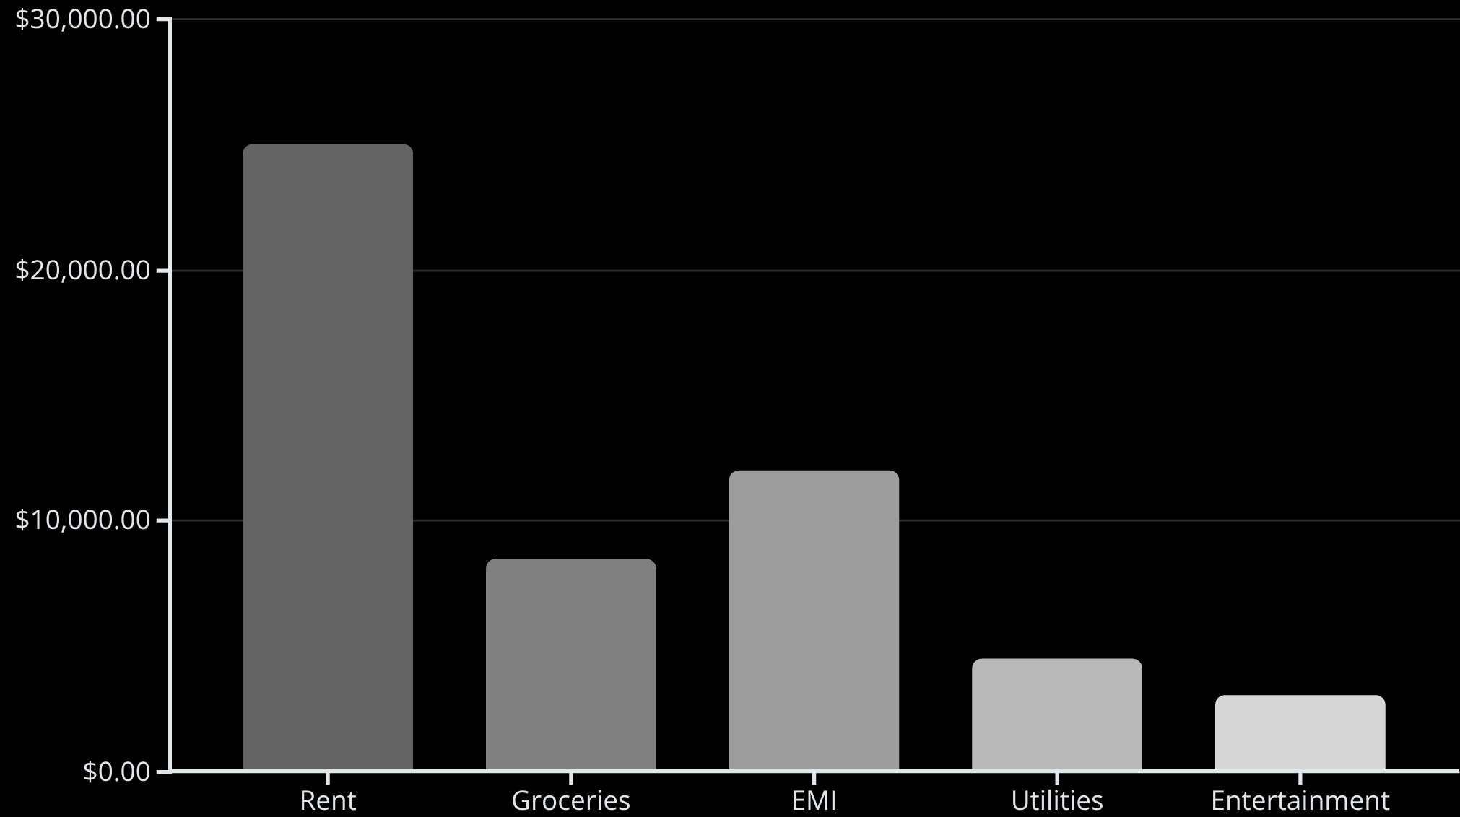
Insight 2: Purpose-Wise Spending Analysis
Understanding where your money goes is essential. This feature breaks down total expenditure by the defined 'Purpose' category.
Categorical Breakdown
The system groups all 'Debited' transactions by the Purpose field and sums the amounts, providing a clear view of spending priorities.
Uses Pandas groupby("Purpose") function.
Results are plotted using a Matplotlib Bar Chart.
X-axis labels are rotated (plt.xticks(rotation=45)) for readability of long purpose names.
This visual helps identify budget overruns in specific categories quickly.
Building on this foundation of understanding where your money goes, next we'll explore how to detect unusual spending behaviors.

Slide 10




Conclusion: Towards Better Financial Control
The Python-based Personal Finance Manager offers a powerful, accessible, and comprehensive tool for financial literacy and control.
Flexibility
Automation
Users can define their own 'Purpose' categories, making the system highly adaptable to individual needs.
Automated calculations of balances and trends reduce manual effort and human error.
Actionable Insights
User-Friendly UI
Trend and category visualizations translate raw data into clear, decision-driving financial insights.
The Streamlit interface ensures that powerful features are accessible to non-technical users.
Ultimately, this system empowers individuals to take charge of their financial destiny, fostering better habits and a more secure future.

